Slide 1
MSSD14 BOE
Informational Meeting – July 19, 2021

Slide 2
Introductions
Current Manitou Springs School Board Members
Tina Vidovich—President; tvidovich@mssd14.org
Natalie Johnson—Vice President; njjohnson@mssd14.org Jack Sharon—Treasurer; jsharon@mssd14.org
Gus Moen—Director; gmoen@mssd14.org
Gary Smith — Director; gsmith@mssd14.org

Slide 3
Purpose of this Meeting
The purpose of this meeting is to:
Give a brief overview of the basics of the role of a Public Education Board Member
Explain the Policy Governance Model
Provide Key dates of the Election Process and additional resources
Including CASB information https://www.casb.org/built-to-serve

Slide 4
2021-22 BOE GOALS
Work as a team with one voice to govern via Board Policy
Ensure that any new Board members have the content knowledge and training needed to govern effectively
Ensure our Board Policies are current and that they provide the framework for all Board decisions
Evaluate the Superintendent as per Board Policy

Slide 5
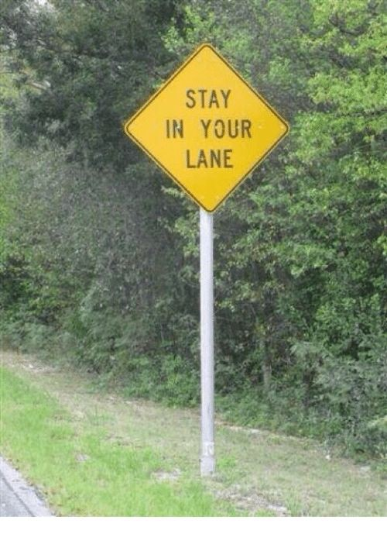
BOE Job Description

Slide 6
“The Board will govern lawfully with an emphasis on (a) outward vision rather then an internal preoccupation, (b) diversity in viewpoints and sufficient understanding of issues, (c ) strategic leadership more than administrative detail, (d) clear distinction of Board and chief executive roles,
(e) collective rather than individual decisions, (f) future rather than past or present, and (g) pro-activity rather than reactivity.”

Slide 7
Job Qualiﬁcations
A candidate for the school board must be a resident of the school district and a registered voter for at least 12 consecutive months prior to the election (19 or older). No person who has been convicted of a sexual offense against a child is eligible to serve on the school board. Because school director elections are nonpartisan, candidates may not campaign as members of a political party.

Slide 8
Responsibilities
SUPERVISORY RESPONSIBILITIES: The school board has direct supervisory responsibility for communicating with and evaluating the performance of the district superintendent. REPORTS TO: The school board reports to the community as its elected trustee. PERFORMANCE RESPONSIBILITIES: The responsibilities of the school board include the ability to function effectively as a team in each of the following
areas*: *These activities are performed as a board of education team, not as an individual school board member
Build School District Leadership Advocate for Public Education
Provide Fiscal Oversight Foster Board Team Effectiveness Manage District Policies

Slide 10
An introduction to Policy Governance
Policy Governance, created by Dr. John Carver, is a model of governance designed to empower a Board of Education (BOE) to fulfill its obligation of accountability for the organization it governs on behalf of the owners.
The model enables the BOE to focus on the larger issues, to have an outward vision, to delegate with clarity, to control the school district’s job without meddling in administrative details, to rigorously evaluate the accomplishments of the school district; to truly lead the school district.

Slide 11
Principles of Policy Governance
Owners of the school district.
BOE decisions are predominately policy decisions.
BOE speaks with one voice and as one governing body.
Ends Policies: what result, for whom, at what cost?
Governance Process: the work of the BOE.
Executive Limitations: the BOE places boundaries on superintendent Means.
BOE policies start broadly.
Board-Superintendent Linkage: the BOE delegates to the superintendent.
BOE delegates only to the superintendent who uses reasonable interpretations.
BOE monitors the superintendent’s progress or results to the Ends Policies.

Slide 12
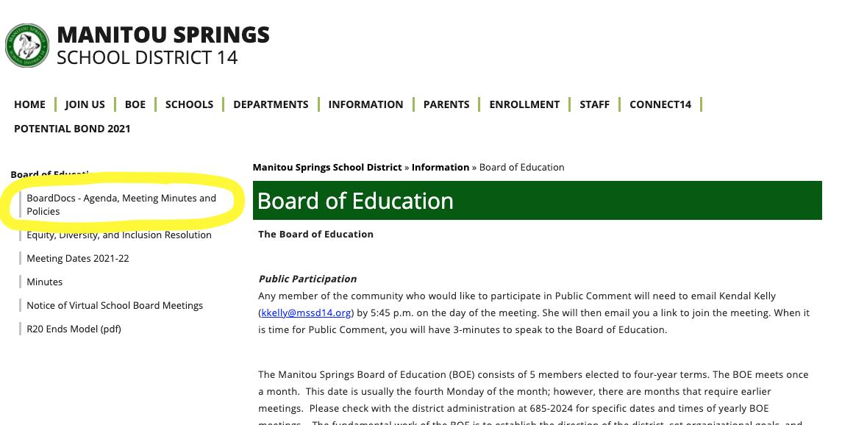
Where to ﬁnd BOE Policies: BBDA

Slide 13
Election Timelines and Events
Important Dates
Aug 4- First Day nominations petitions may be circulated
Aug 27-Nominations petitions and accompanying forms must be filed by this date
Aug 30-Deadline to file as a write-in candidate
Sept 3-First date a district may cancel the election if no contest
Nov 2 Election Day
Get ready to hone your speaking and writing skills
Numerous candidate forums and publications
CASB Guide for Candidates and Veteran Board Members

Slide 14
Running a Campaign Manitou Style
Don’t leave a footprint, or at least only a small one
Non-partisan
Stay positive -promote yourself and the district
Listen to your community

Slide 15
Interested?
Attend Board Meetings and Work Sessions
Speak with various Board members, past and present Gauge your capacity to be fully involved
Assess your reasons for serving as a school board member

Slide 17
Questions, Answers, Feedback?

